Slide 1
Title SlideTitle: Automated Enterprise Onboarding Solution Subtitle: Streamlining IT Service Management with ServiceNow Presented by: Ariful Mondal

Slide 2
The Problem Statement (The "Why") Manual Bottlenecks: Explain that manual onboarding leads to delays in equipment and account access. Risk: High chance of human error and inconsistent user experience for new hires. Goal: To create a "Zero-Touch" ticket generation system for seamless onboarding.

Slide 3
Solution Architecture Front-End: Service Catalog with dynamic UI Policies.Logic Engine: Flow Designer for backend automation.Process: Aligned with ITIL V4 Request Management standards.

Slide 4
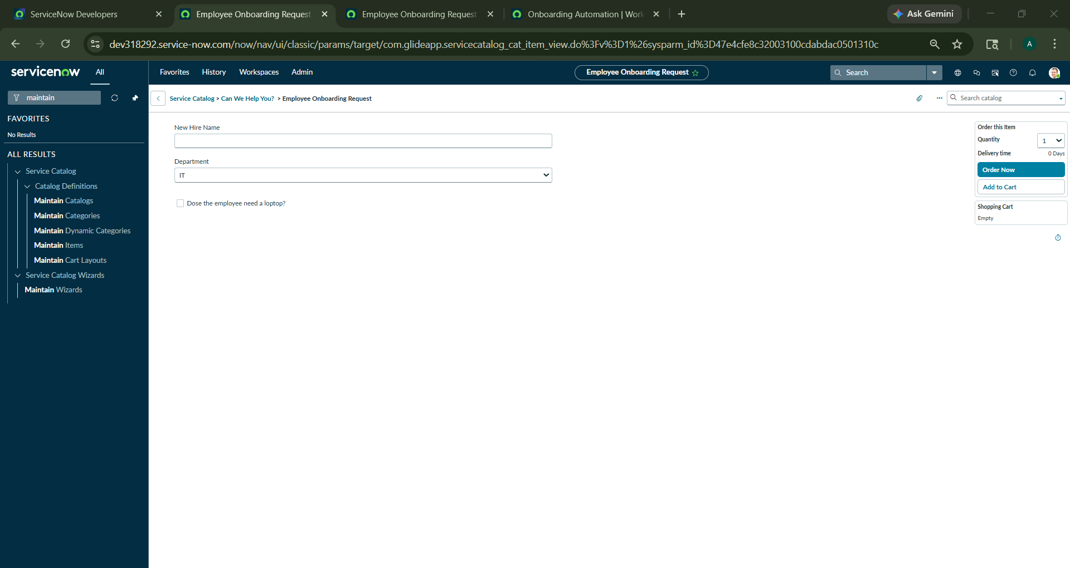

User Experience (The Form) Point 1: Clean interface using a single-page request form. Point 2: Field visibility logic—hardware options only appear when requested, reducing form clutter.

Slide 5
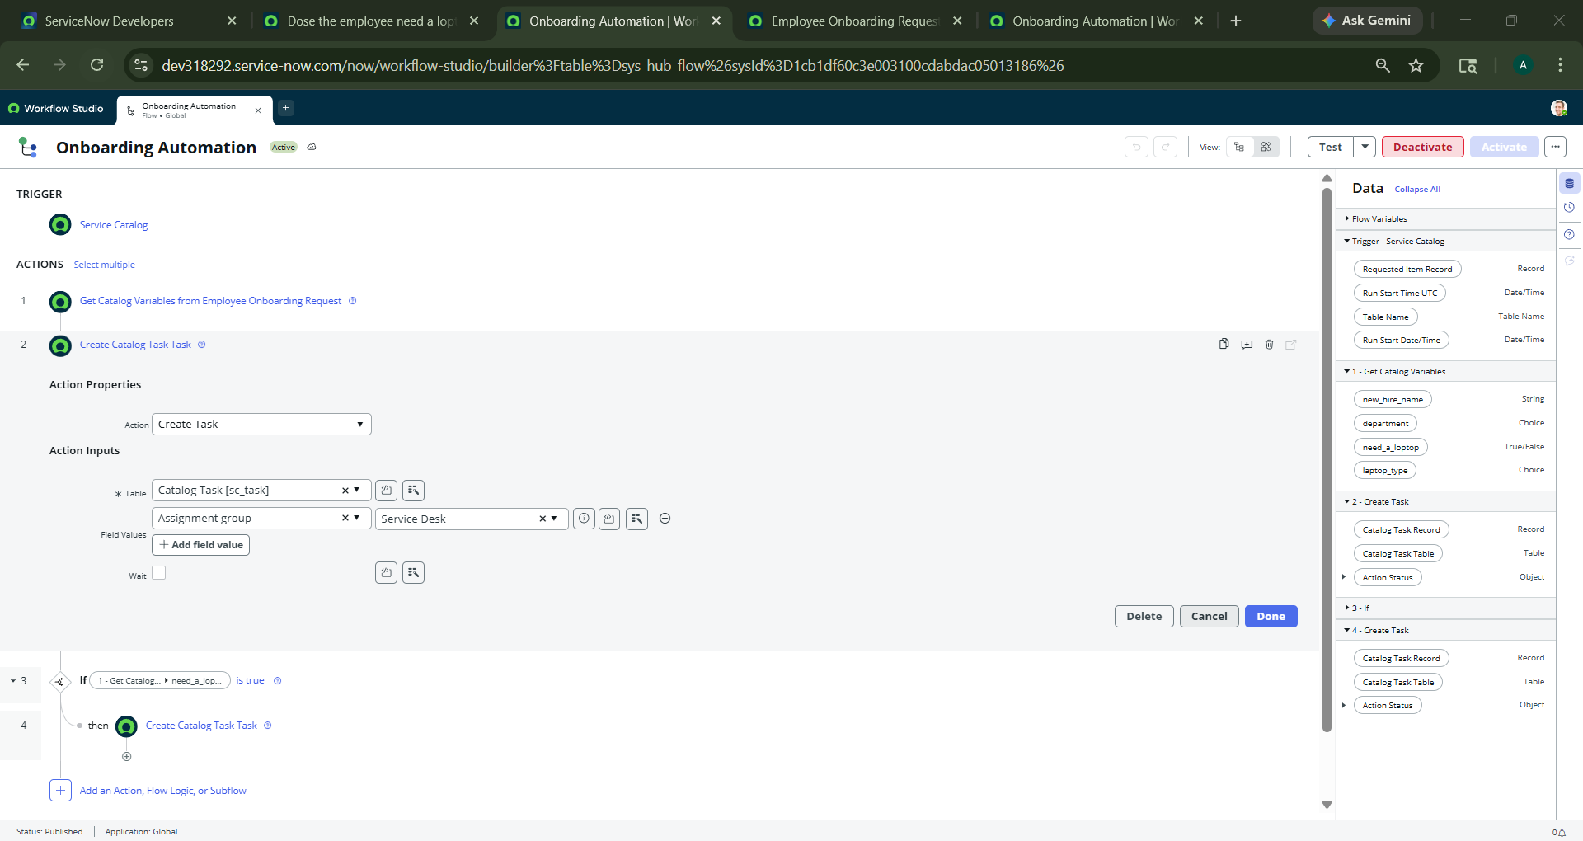
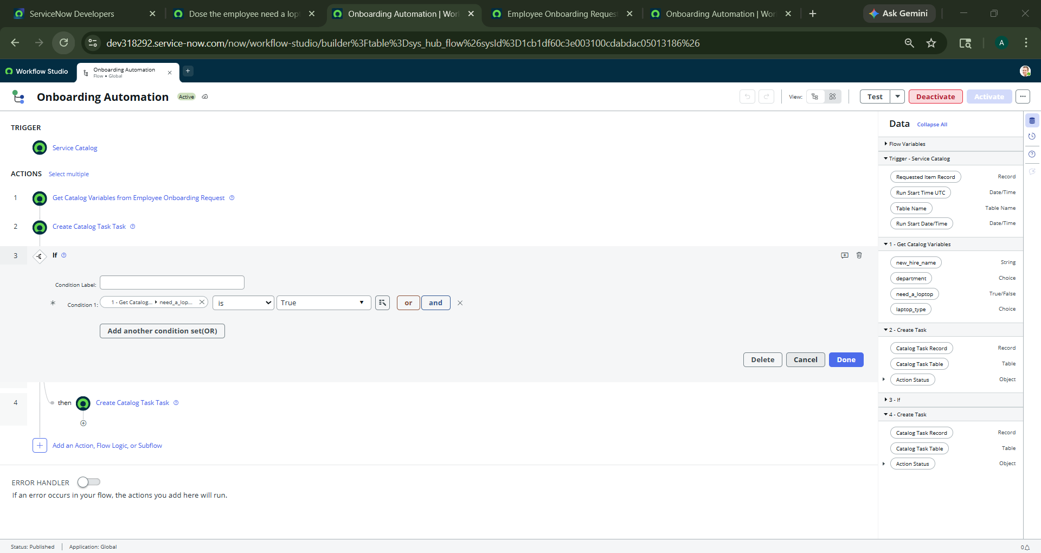
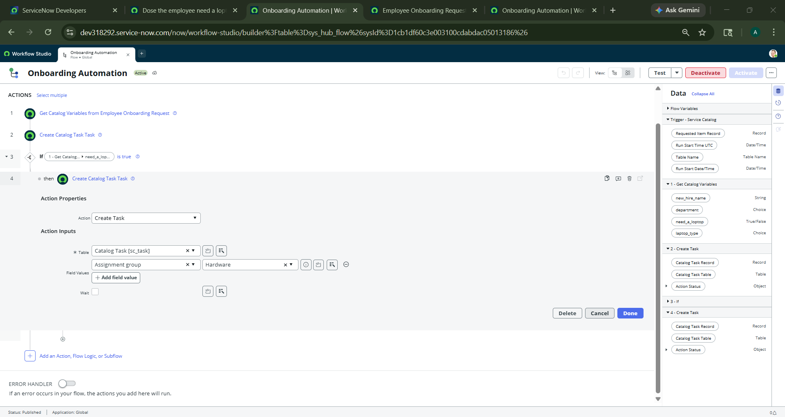
The Automation Engine (The Flow) Trigger: Instant start upon "Order Now." Decision Logic: Explain the If/Then branch for the hardware team. Efficiency: Multiple teams (IT and Hardware) receive tasks simultaneously, not sequentially.

Slide 6
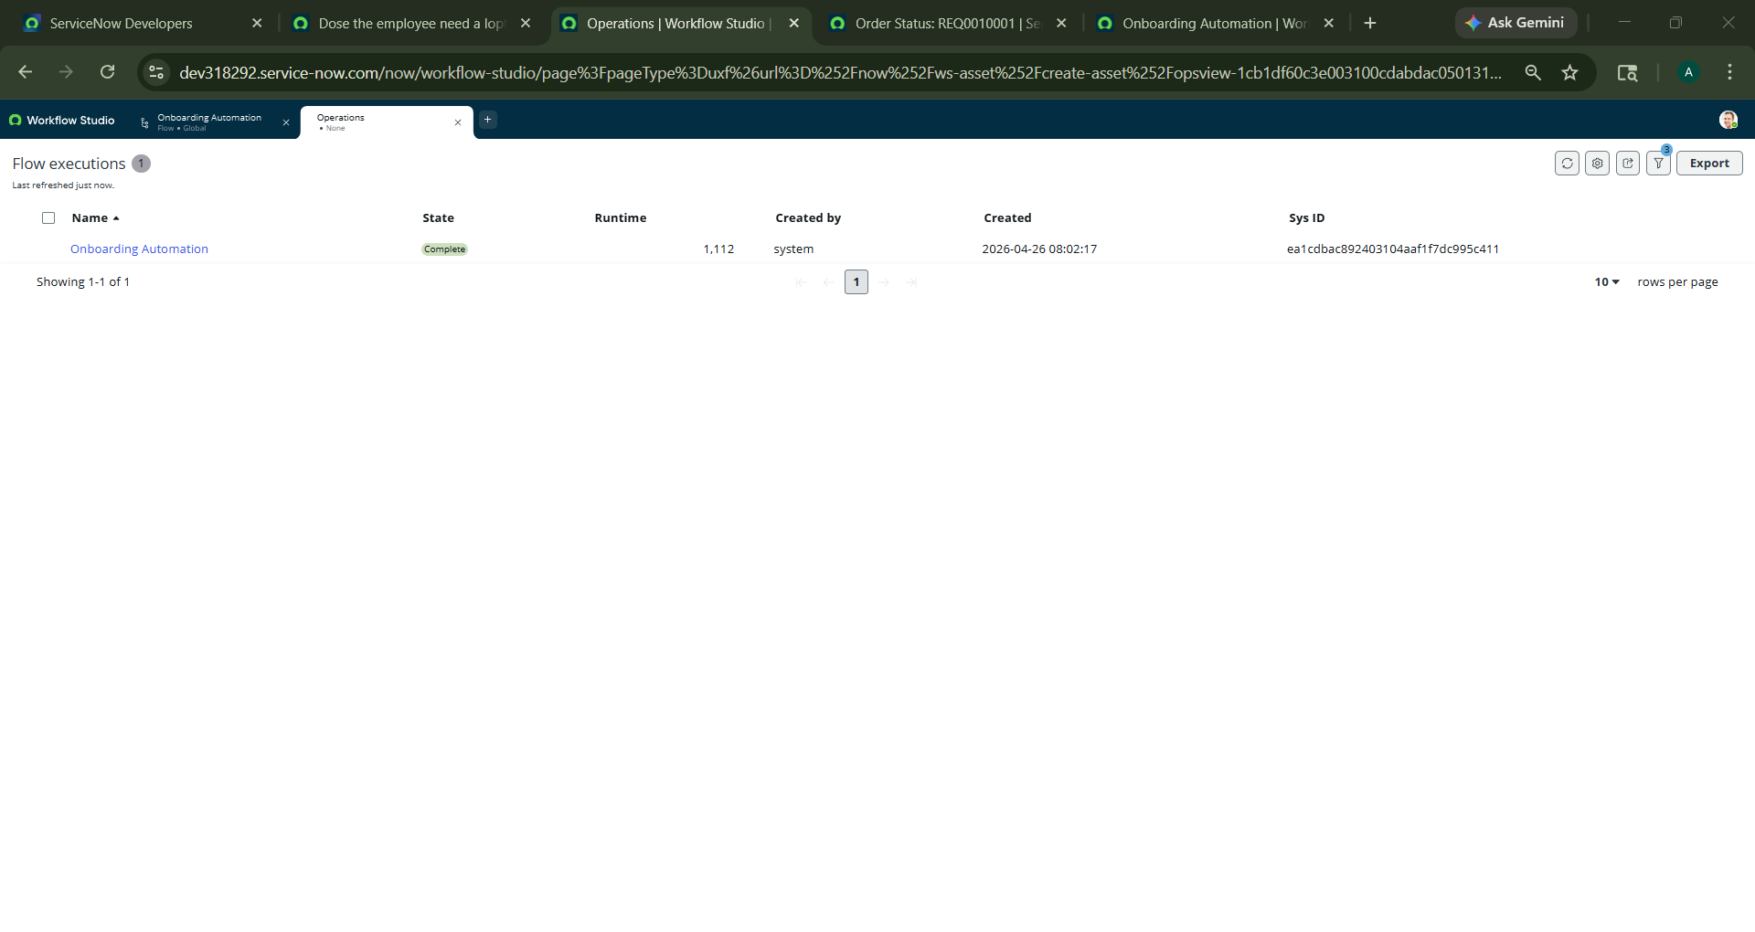
Results & Success Metrics Proof of Work: Show the "Complete" status of the execution. Key Outcome: Simulated reduction in manual ticket handling and improved data accuracy.

